Slide 1
18CSC304J COMPILER DESIGN
UNIT 4
SESSIONS 3 (b)

Slide 2
Topics that will be covered
Intermediate Languages
Declarations

Slide 3
DECLARATIONS

Slide 4
Declarations
When the declaration of a name in a procedure or block is examined, we can layout storage for names local to the procedure
For each local names, an entry is created in the symbol table with information like
Name
Type
Relative address of the storage
The relative address is an offset from the base of the field for local data in an activation record

Slide 5
Declarations in a Procedure
All the declarations in a single procedure can be processed as a group
A global variable “offset” is used to keep track of the next available relative address
The grammar for Declarations can be written as
P → D
D → D ; D
D → id : T
T → integer
T → real
T → array [ num ] of T₁
T → ↑ T₁
The non-terminal P generates a sequence of declarations of the form id : T

Slide 6
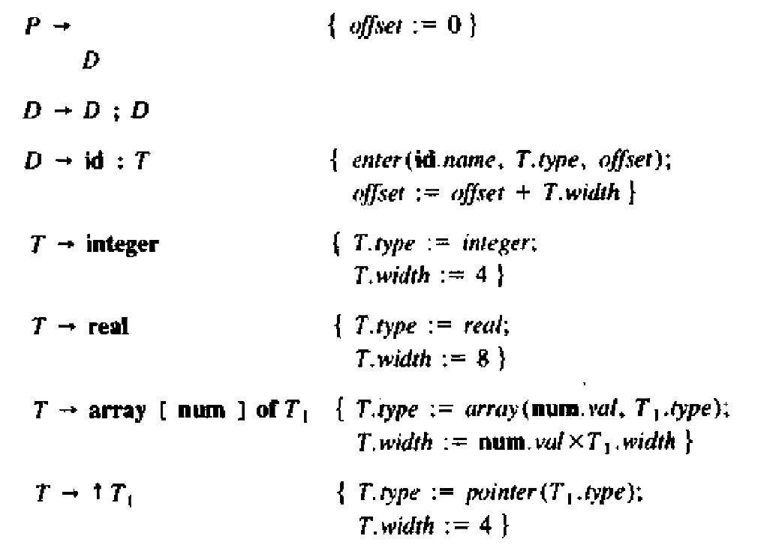
Translation Scheme for Declarations
Initially offset is set to 0
As each new name is seen, the name is entered in the symbol table, with offset equal to the current value of offset and offset is incremented by the width of the data object
The procedure enter(name,type,offset) creates a symbol table entry for name
Two synthesized attributes type and width are used for non-terminal T
Integers have width 4 and reals have width 8
The width of an array is obtained by multiplying the width of each element by the number of elements in the array
The width of each pointer is assumed to be 4

Slide 7
Keeping track of scope information
In a language with nested procedures, suppose that there is a separate symbol table for each procedure
The grammar for the declaration of a procedure is
P → D
D → D ; D | id : T | proc id ; D ; S
One possible implementation of a symbol is a linked list of entries for names
A new symbol table is created when a procedure declaration D → proc id D ; S is seen and for the declarations in the new procedure, entries are created in the new table
The new table points back to the symbol table of the enclosing procedure
The procedure enter is told which symbol table to make an entry in

Slide 8
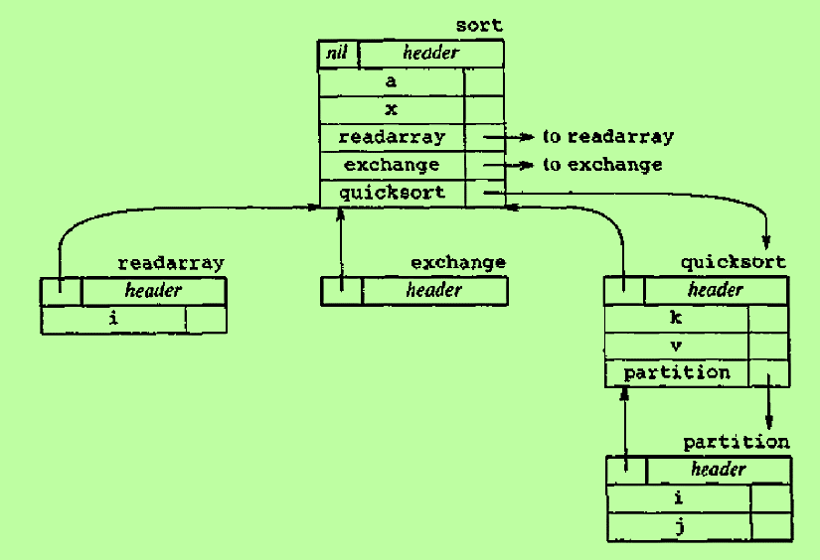
Keeping track of scope information – cont..
The symbol tables for five procedures are shown
The nesting structure of the procedures can be deduced from the links between the symbol tables
The symbol tables for procedures readarray, exchange and quicksort point back to that for the containing procedure sort, consisting of the entire program
Since partition is declared within quicksort, its table points to that of quicksort

Slide 9
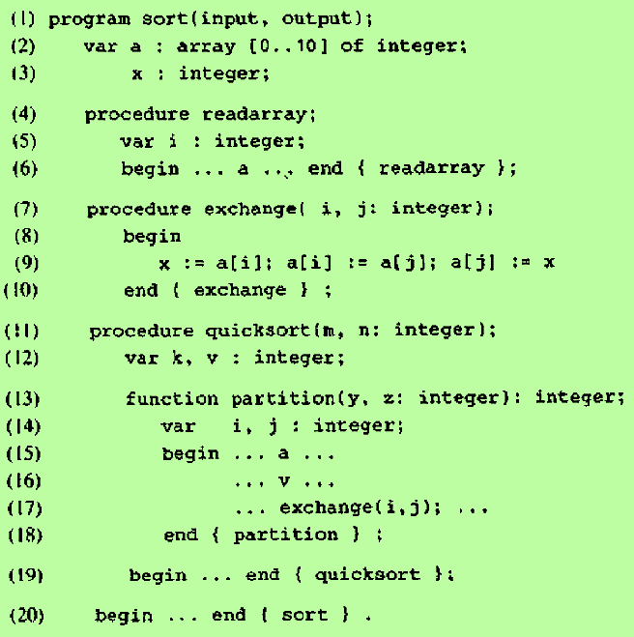
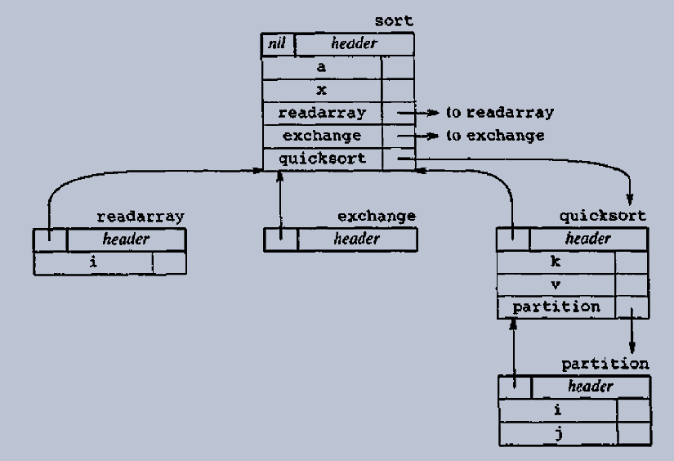
Keeping track of scope information – cont..

Slide 10
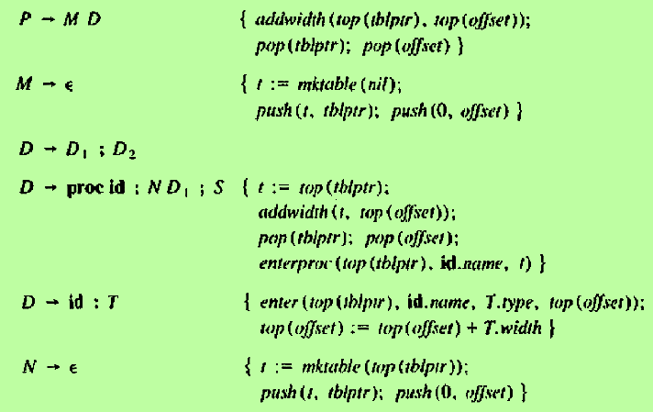
Translation Scheme for Declarations in Nested Procedures

Slide 11
Operations used in the Translation Scheme
mktable(previous)
Creates a new symbol table and returns a pointer to the new table
The argument previous points to a previously created symbol table (enclosing procedure)
The pointer previous is placed in the head for the new symbol table
Procedures can be numbered in the order they are declared and the number can be kept in the header
enter(table, name, type, offset)
Creates a new entry for name in the table pointed to by table
Enter type and relative address offset in the entry
addwidth(table, width)
Records the cumulative width of all the entries in table in the header
enterproc(table, name, newtable)
Creates a new entry for the procedure name in the symbol table pointed to by table
newtable points to the symbol table for name

Slide 12
Stacks used
tblptr
It holds pointers to symbol tables of the enclosing procedures
The pointer to the current symbol table is on the top
offset
It stores the offset of the nested procedures
The top element of offset is the next available relative address for a local name of the current procedure

Slide 13
Explanation of the Translation Scheme
Action for nonterminal M
A symbol table is created for the outermost procedure by the operation mktable(nil)
The stack ‘tblptr’ is initialized with a pointer to the symbol table
The relative address 0 is pushed onto stack offset
Action for nonterminal N
The operation mktable(top(tblptr)) creates a new symbol table
A pointer to the new table is pushed to the stack ‘tblptr’
0 is pushed onto stack offset
Action for each variable declaration id:T
An entry is created for id in the current symbol table
The top of stack offset is incremented by T.width

Slide 14
Explanation of the Translation Scheme – cont..
Action for D → proc id ; ND₁ ; S
The width of all declarations generated by D1 is on top of the stack offset. It is recorded using addwidth
Stacks tblptr and offset are then popped and we revert to examining the declarations in the enclosing procedure
The name of the enclosed procedure is entered into the symbol table of its enclosing procedure

Slide 16
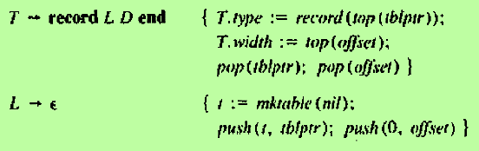
Field names in records
Actions Taken
After the keyword record is seen, the action associated with the marker L creates a new symbol table for the field names
A pointer to this symbol table is pushed onto the stack tblptr
Relative address 0 is pushed onto the stack offset
The action for D → id : T enters information about the field name id into the symbol table
After all the fields are examined, the top of the stack offset will hold the width of all data objects within the record
The action following end will return this width as T.width
T.type is obtained by applying the constructor record to the pointer to the symbol table for this record
The productions given below generates records
T → record D end
Translation Scheme

